Slide 1
Ivy Tech Multi-Purpose Center
Charity Fischer

Slide 2
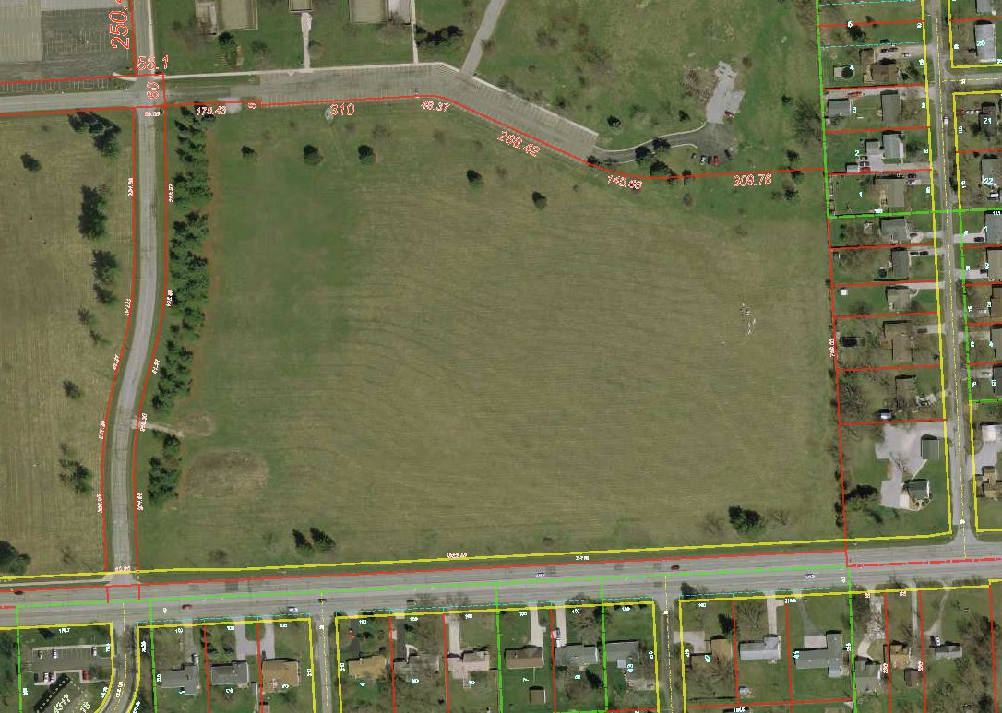
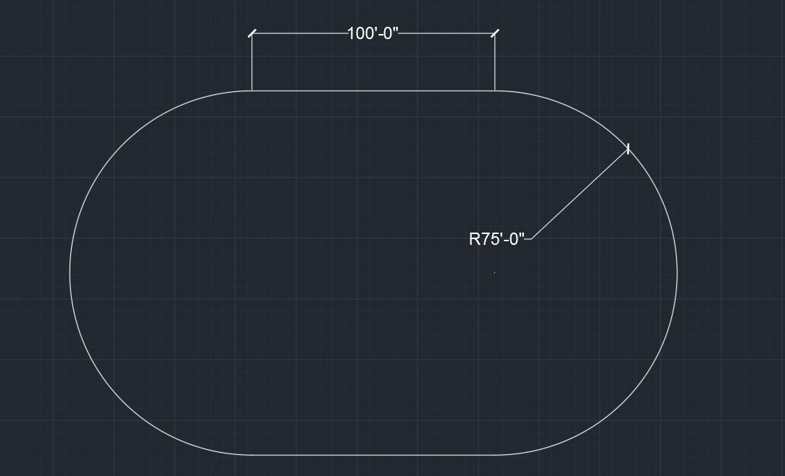
The Lot

Slide 3
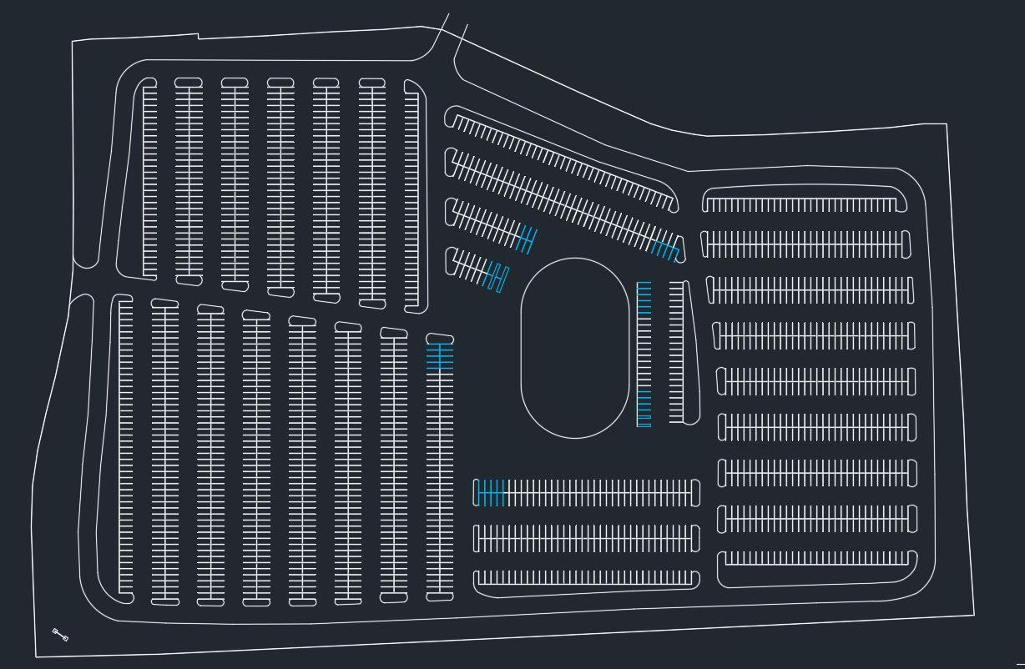
The Parking Lot
1,925 Parking Spots
38 handicapped
Roads are 25’
Between parking spaces is 27’
189 faculty spots

Slide 4
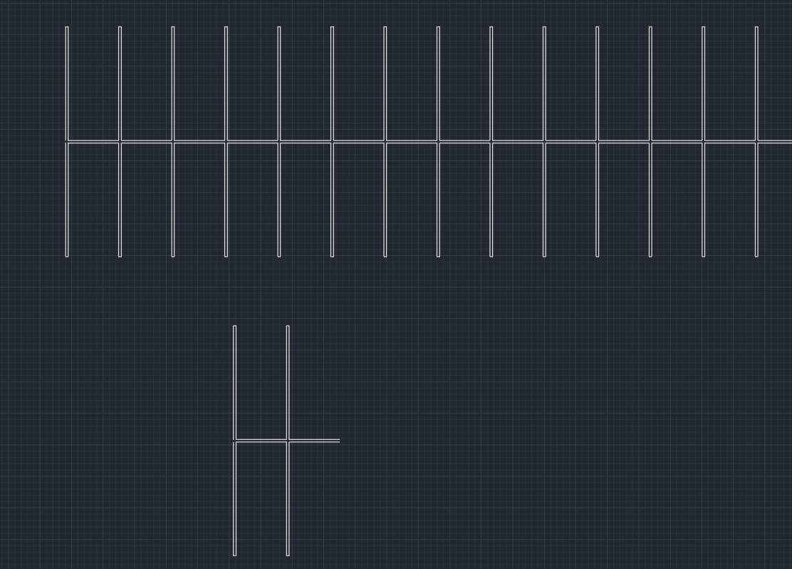
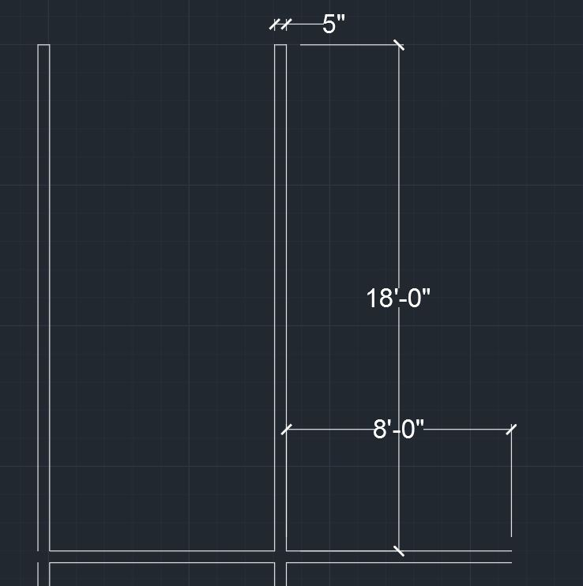
Parking Spaces

Slide 5
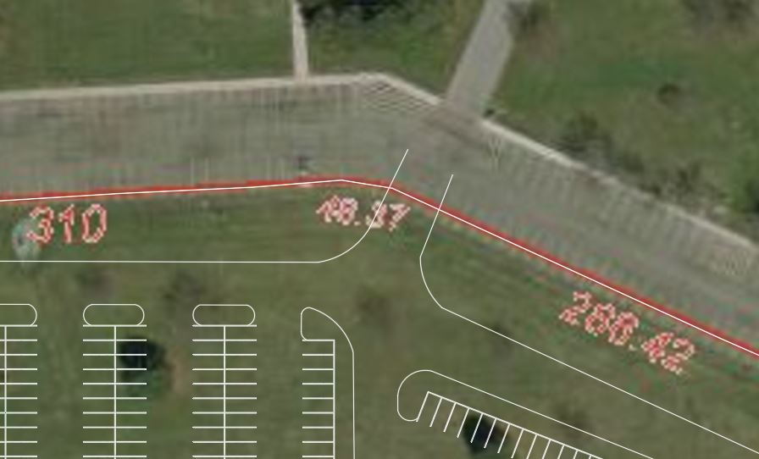
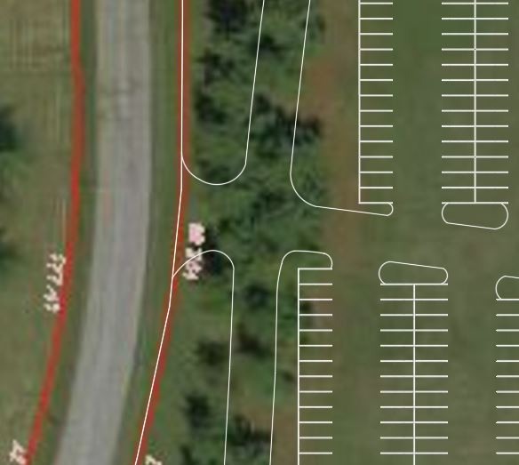
Entrances

Slide 6
Advantages
Mass amount of parking
Building centered on lot
Road that circles entire lot
Two enterances
Nice looking turf

Slide 7
Disadvantages
Some roads are narrow
Farthest spot is 720 feet away from building
Only 38 handicap spots
No Lights

Slide 8
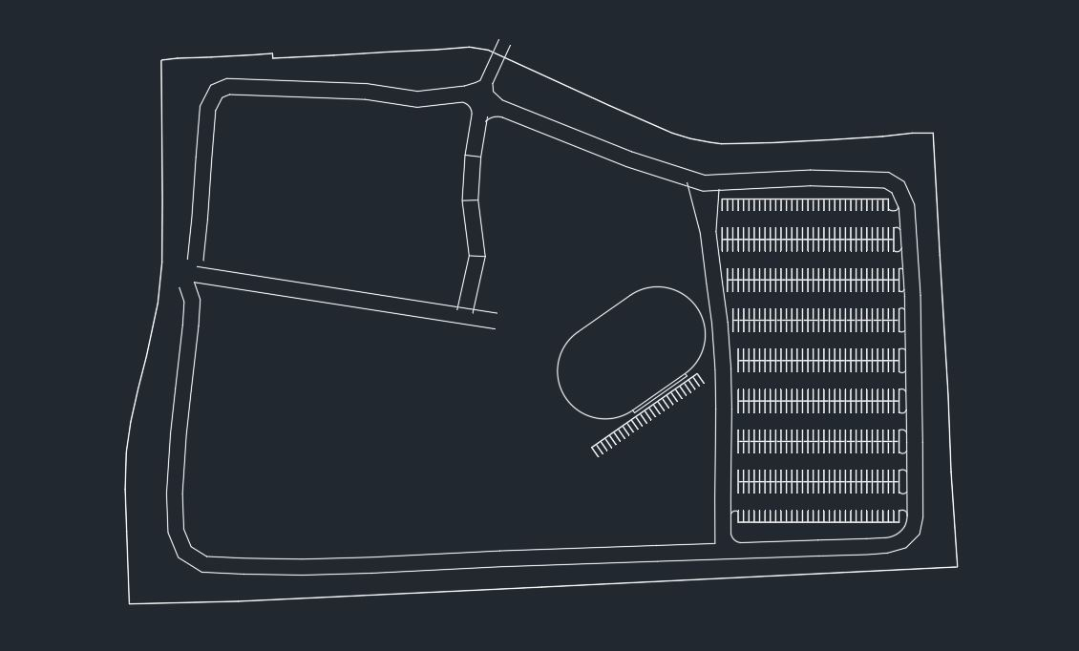
How I did it
Mline as roads 25’ across
Outline lot with mline and intermingle roads to lot

Slide 9
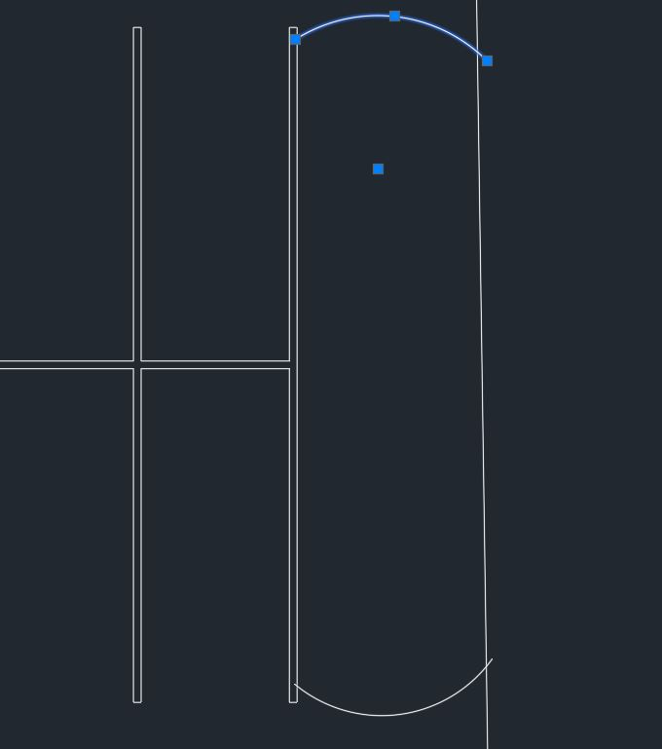
How I did it
Arc tool for turf
Trim to clean it up

